Slide 1


How to really use Google NotebookLM update Part 3

Slide 2
What you will learn
What is NotebookLM?
Getting NotebookLM
Understanding Notebooks
Using the Notebook Guide
Creating Audio Overviews / Podcasts
Adding Notes
Asking Questions
Working with Answers
Sharing Notebooks
Use Cases

Slide 3

Asking Questions

Slide 4
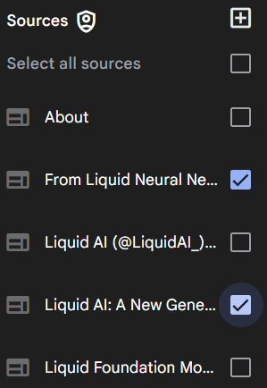
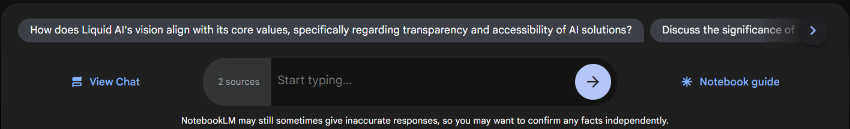
Asking Questions: Sources
Once you have uploaded your sources, you can ask the model questions about your source material.
You can use the checkbox on each source to include or exclude certain sources the model should use to answer your question in a notebook.

Slide 5
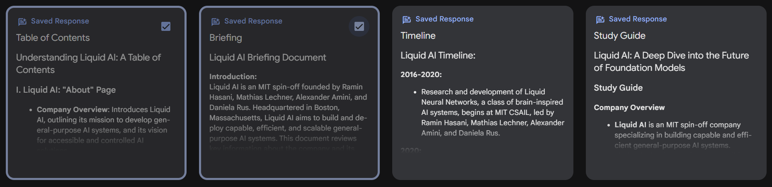
Asking Questions: notes
Once you have created your notes, you can ask the model questions about your notes.
You can use the checkbox on each note to include or exclude certain notes the model should use to answer your question in a notebook.

Slide 6
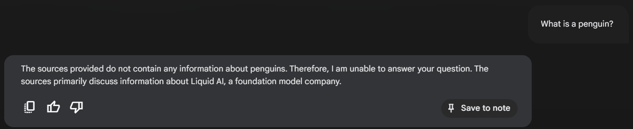
Asking non-related questions

Slide 7
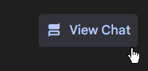
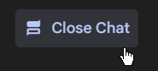
Opening / closing chat

Slide 8
chat history is not retained

Slide 9
Demo: questioning sources and notes

Slide 10

Working with answers

Slide 11
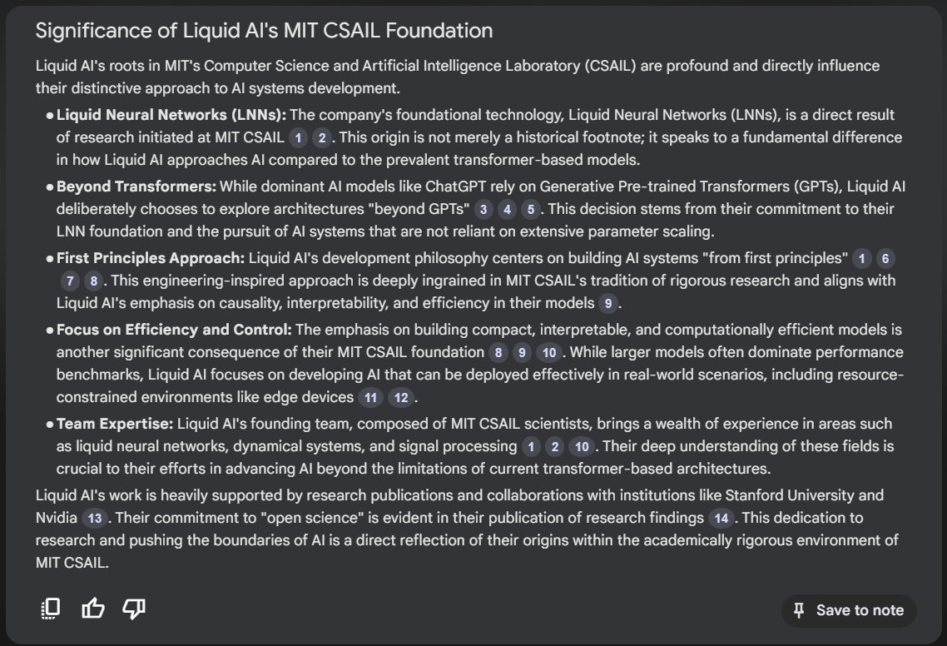

Slide 12
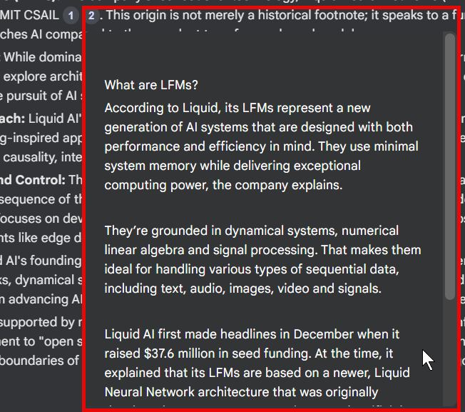
Citations

Slide 13
Citations
Citations are quotes from your source documents that NotebookLM uses to build its responses. Each citation is a specific block of text from your source that is considered relevant to your question. Citations are direct quotes, and seeing these passages can help you check the accuracy of the response and find the original quote.
You can click on a citation to see the highlighted text from the original source.

Slide 14
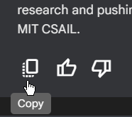
Copying the answer

Slide 15
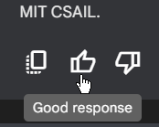
Giving feedback

Slide 16
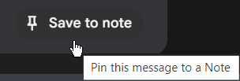
Save to note (saved response)

Slide 17




Notes:
https://www.youtube.com/channel/UC35ZpwldGw7ZJ5R-2sLijzw

Slide 18
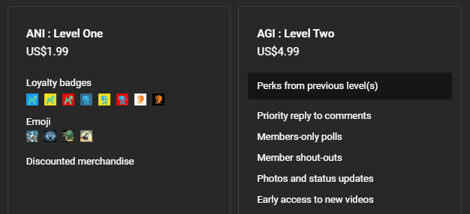
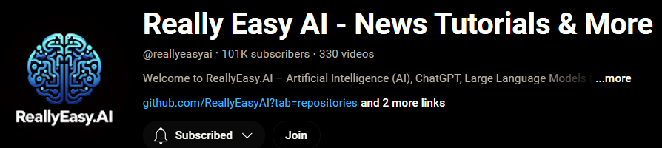
Become a Member!
Notes:
https://www.youtube.com/channel/UC35ZpwldGw7ZJ5R-2sLijzw/join

Slide 19

https://www.youtube.com/@AINewsFresh

Slide 20
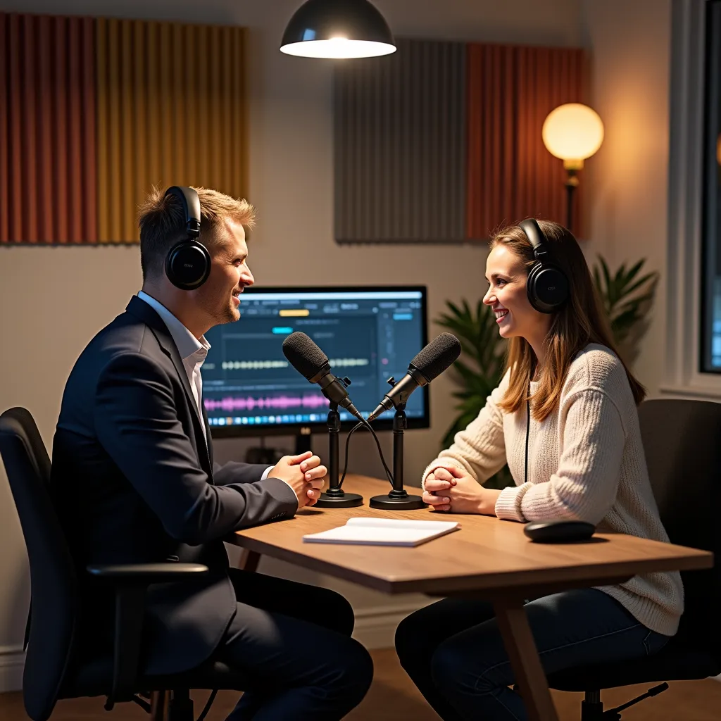
https://www.youtube.com/@DailyAINewsPodcast

Slide 21

Sharing Notebooks

Slide 22
Sharing Notebooks
You can share notebooks by opening a notebook and clicking the “Share” icon in the top-right corner of the screen. You can grant either Viewer or Editor access to another user by adding their email address.
A viewer will have read-only access to all the source documents and notes you shared with them in the shared notebook
An editor will be able to view, add, or remove sources and notes in your shared notebook as well as share it further with other users

Slide 23
Serious Sharing Limitations
Personal Gmail accounts can share a notebook with at most 50 other individual users with Gmail accounts, and cannot share with Google Groups.
Enterprise and EDU accounts (e.g. email@mycompany.com or email@uni.edu) can share a notebook with an unlimited number of individual users and google groups within the same organization.

Slide 24

Use Cases

Slide 25
Research Tool
NotebookLM excels at workflows that involve synthesizing information dispersed across multiple documents, which makes it a valuable tool for students, scholars, journalists, analysts, and many other "knowledge worker" professions.
If your research material involves PDFs or Google Docs, you can create a notebook for the project you're working on, and immediately add the relevant documents as sources. Within seconds, NotebookLM becomes a virtual research assistant, capable of answering questions or tracking down references based entirely on the source materials you've supplied.

Slide 26
Meeting or Interview Transcripts
NotebookLM can help you remember, summarize, and quickly find relevant passages from transcripts that you upload as sources. A documentary filmmaker or podcast producer, for instance, can use NotebookLM to store dozens of transcripts, and ask open-ended questions based on information in all of the original transcripts.
Or a financial analyst could upload the transcripts from a few years’ worth of earnings calls for a company, and ask questions like: “What did Bob Packman say about profitability in Q3 of 2022”? Or “what were the new products the CEO mentioned that they were so excited about?”

Slide 27
Help Center or Onboarding Guide
The combination of a chat interface with source grounding makes NotebookLM an excellent platform for help documentation or as a guide for new users, customers, or colleagues trying to understand a product or an organization.
Creating a help center is really just a matter of assembling documents that explain your product, service, or organization in a clear and comprehensive way. Once you’ve assembled the sources, create a notebook and upload the sources. At that point, NotebookLM will be able to answer questions based on information in those documents. You can share the Notebook with others in “Viewer” mode.

Slide 28


